Slide 1


Analysis of Topic Trends
In Biomaterial Research
Bibliometric Data Analysis of Topics
Wiley Field Consulting Project Review

Slide 2




Team Members Introduction
Jingsi Gong
Shivi Jain
Shuai Wang
Yuhan Hu
Dr. Chris Asakiewicz
BIA-686

Slide 3
Topic
Analysis
Social Media
Prediction Model
Motivation

Slide 4

Motivation

Slide 5
Motivation
To investigate:
How
Social Media
might be used as a
Leading indicator
of future topic
Notes:
Biomaterial
Biomedical material
Biomaterial engineering
Social media

Slide 6

Topic Analysis

Slide 7
Topic Analysis
Topic Extraction Process
TF-IDF
LDA
Define emerging and shrinking Topics
Features analysis
Journal Impact Factor
Funding agencies
Citation
Notes:
Biomaterial
Biomedical material
Biomaterial engineering
Social media

Slide 8
Topic Analysis | Topics Extraction Process
Data Source: Web of Science Database
Search Terms: “Biomaterials” or “Biomedical Materials”
Record Count: 43480
Timeline: 1972-2018
Article Keywords
Title
Unification
LDA Model
TF-IDF Filtering
Topics
Topics
Notes:
Biomaterial
Biomedical material
Biomaterial engineering
Social media

Slide 9
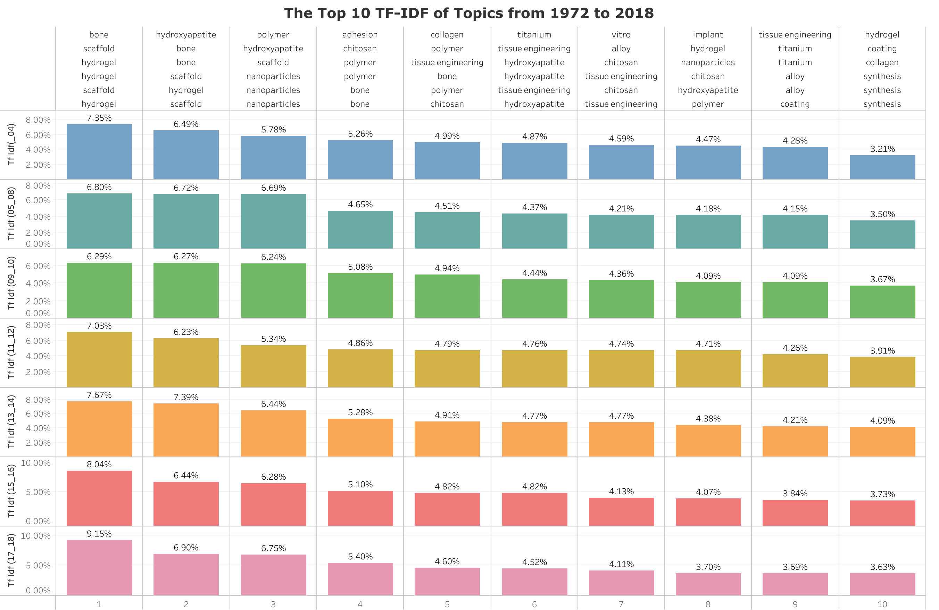

Slide 10
Bone
Polymer
Chitosan
Tissue Engineering
Hydrogel
Scaffold
Nanoparticles
Regeneration
Adhesion
Microstructure
Interested 10
Topics

Slide 11
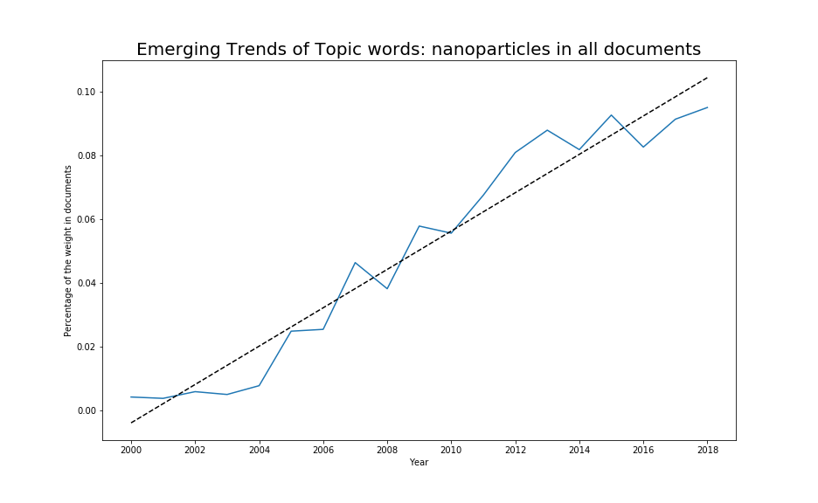
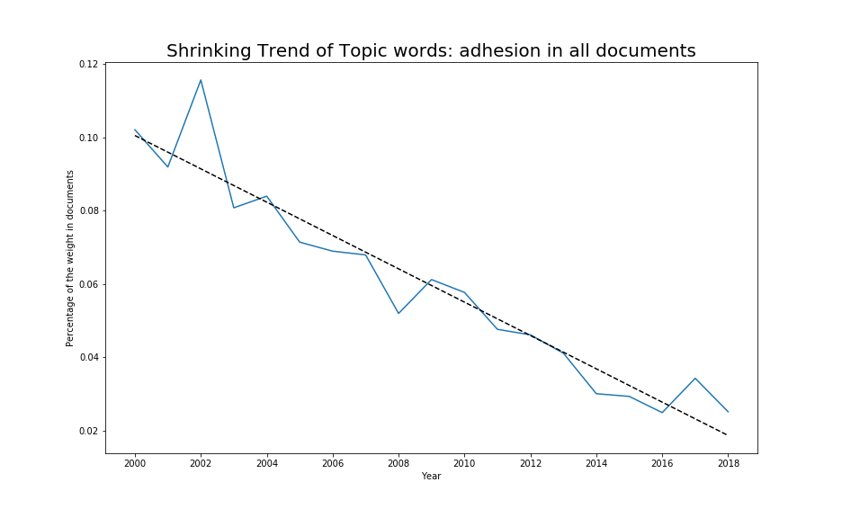
Topic Analysis | Emerging and Shrinking Topics
The emerging trend is discerned with the positive coefficient of the linear fit, while the shrinking trend is correlated with the negative one.
The emerging topics includes tissue engineering, scaffold, hydrogel, chitosan, regeneration, microstructure, nanoparticles, while the topics of polymer, bone and adhesion are shrinking.
Notes:
Biomaterial
Biomedical material
Biomaterial engineering
Social media

Slide 12
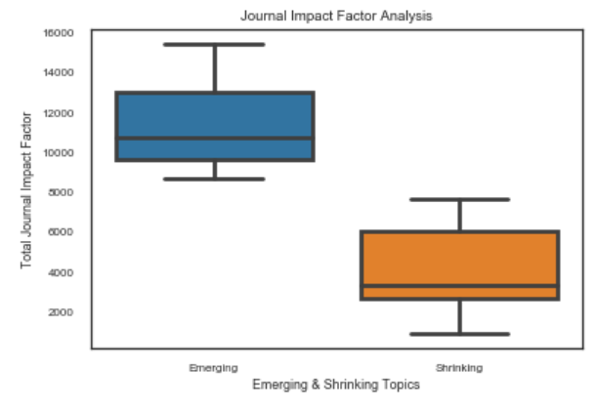
Topic Analysis | Features analysis
Topics like Regeneration, Tissue, Biomaterials and Scaffolds, Tissue, Bone etc have high Journal impact factor, which are also emerging topics as analyzed before.
Topics like Microscopy, Laser, dna, beta and strength etc have very low Journal impact factor which are also shrinking topics.
Notes:
Biomaterial
Biomedical material
Biomaterial engineering
Social media

Slide 13

Social Medial analysis

Slide 14








Social Medial analysis
Scholar
Data description
Notes:
Social media refers to the means of interactions among people in which they create, share and exchange information and ideas in virtual communities and networks
4 type social media: blogs, including (3); Google, including (2); Twitter; YouTube.
For social media, we collected the number of publications for each topic in each year from 2000 to 2018.

Slide 15
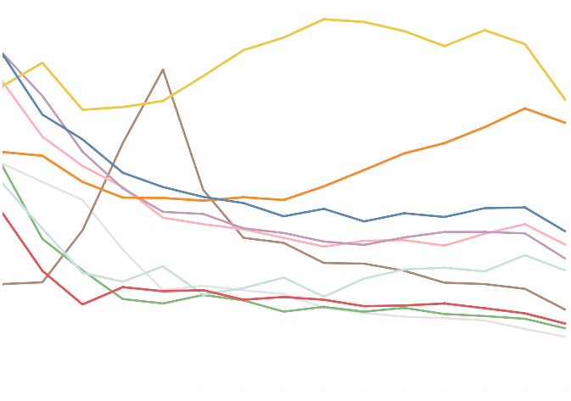
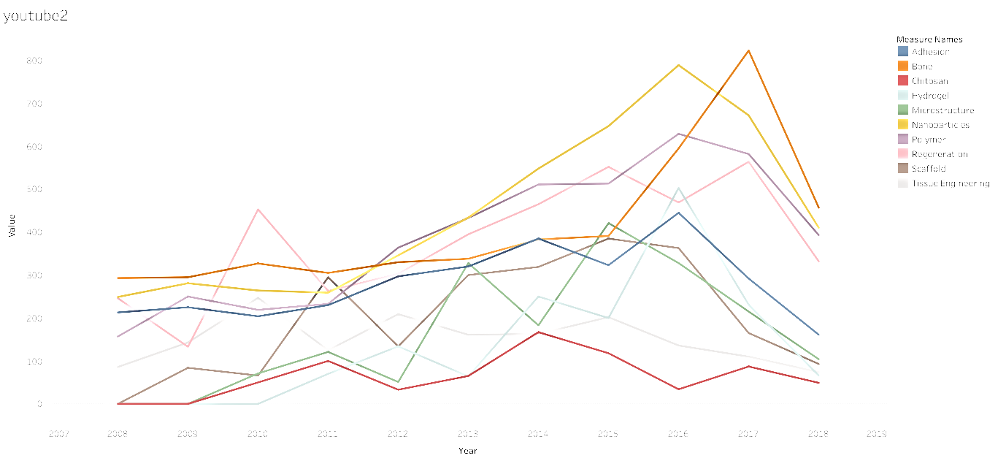
1100
1000
900
800
700
600
500
400
300
200
100
0
Measure Names
Adhesion
Bone
Chitosan
Hydrogel
Microstructure
Nanoparticles
Polymer
Regeneration
Scaffold
Tissue Engineering
2005 2006 2007 2008 2009 2010 2011 2012 2013 2014 2015 2016 2017 2018

Slide 16
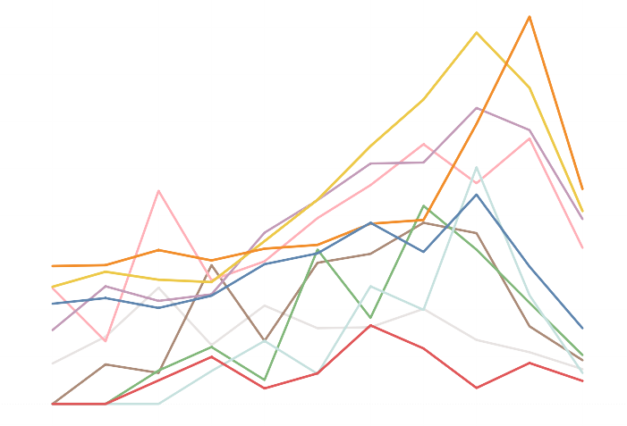
800
700
600
500
400
300
200
100
0
Measure Names
Adhesion
Bone
Chitosan
Hydrogel
Microstructure
Nanoparticles
Polymer
Regeneration
Scaffold
Tissue Engineering
2007 2008 2009 2010 2011 2012 2013 2014 2015 2016 2017 2018 2019

Slide 17
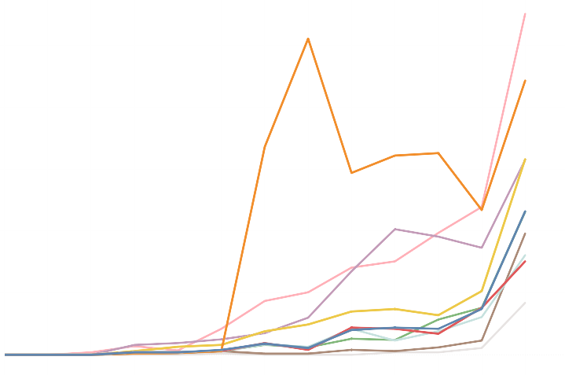
500
400
300
200
100
0
Measure Names
Adhesion
Bone
Chitosan
Hydrogel
Microstructure
Nanoparticles
Polymer
Regeneration
Scaffold
Tissue Engineering
2006 2007 2008 2009 2010 2011 2012 2013 2014 2015 2016 2017 2018 2019
Notes:
Twitter: was founded in 2006. Num around 2006 is nearly 0. All topics began to increase from 2012. Main reason may be popularity of smartphone.

Slide 18
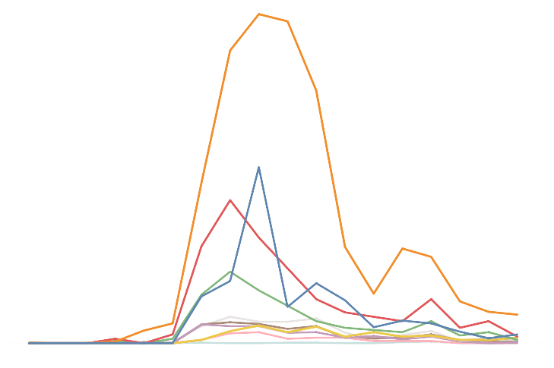
600
500
400
300
200
100
0
Measure Names
Adhesion
Bone
Chitosan
Hydrogel
Microstructure
Nanoparticles
Polymer
Regeneration
Scaffold
Tissue Engineering
2000 2002 2004 2006 2008 2010 2012 2014 2016 2018
Notes:
Science blog: also founded in 2006. All topics increase from 2006 to 2008. Num of publication stay large between 2006—2011, and become small after 2011. Shift from traditional social media such as blogs to instant application such as Facebook and Twitter.

Slide 19
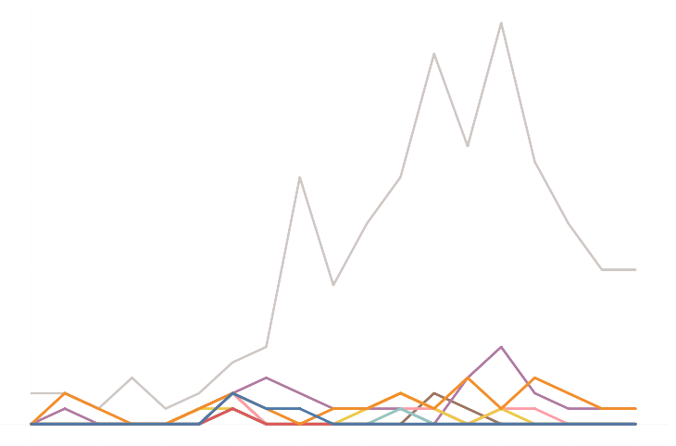
25
20
15
10
5
0
Measure Names
Adhesion
Bone
Chitosan
Hydrogel
Microstructure
Nanoparticles
Polymer
Regeneration
Scaffold
Tissue Engineering
2000 2002 2004 2006 2008 2010 2012 2014 2016 2018

Slide 20

Validation Model

Slide 21
Modeling
Multi Linear Regression
Validate whether Social Media is significant in determining shrinking/ emerging topics
Time Series
Predict the future topic trend by analyzing time-series of Social Media past trends
Notes:
Biomaterial
Biomedical material
Biomaterial engineering
Social media

Slide 22
Multi Linear Regression
Multiple linear regression is a statistical technique that uses several explanatory variables to predict the outcome of a response variable. The goal of multiple linear regression (MLR) is to model the relationship between the explanatory and response variables.

Slide 23
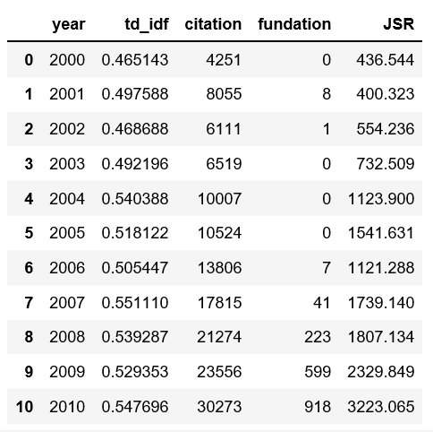
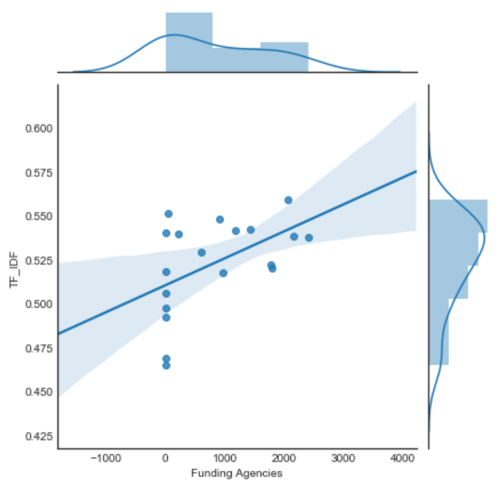
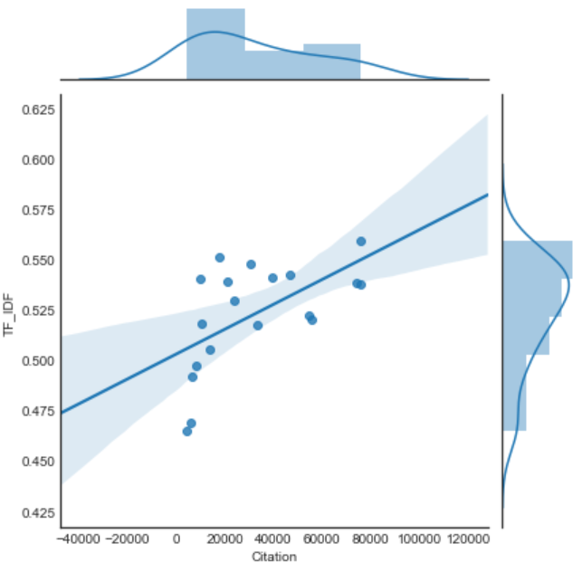
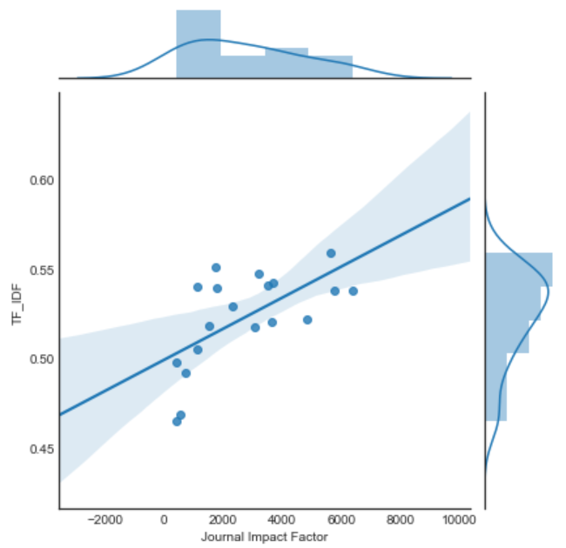
Web of Science Dataset

Slide 24
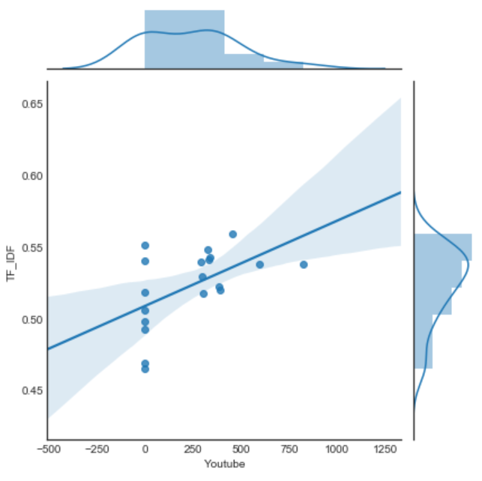
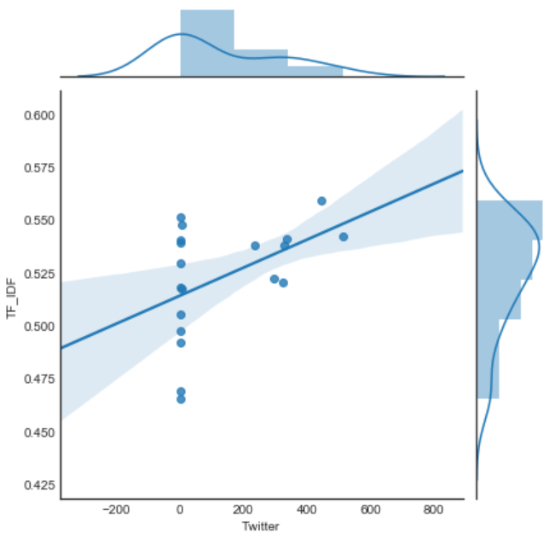
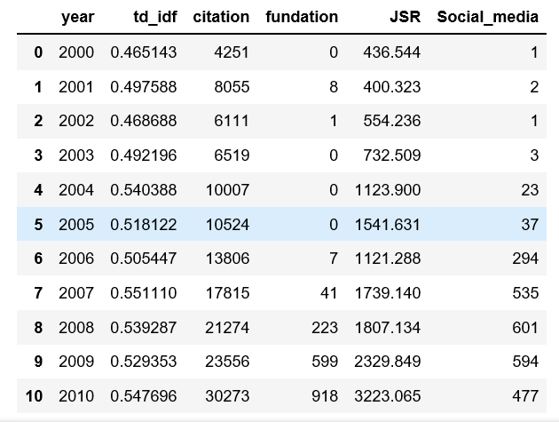
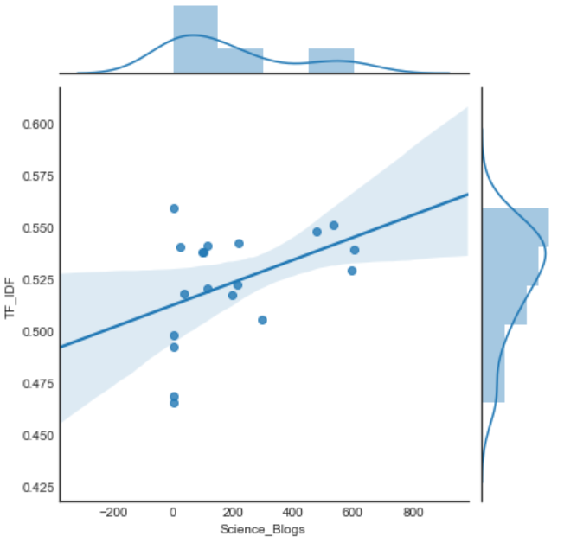
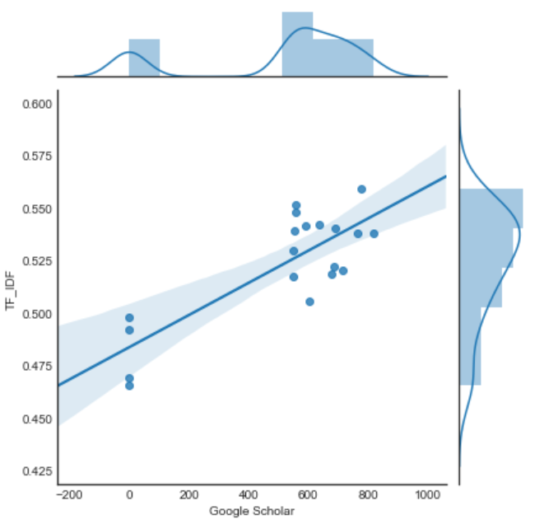
Social Media Dataset

Slide 25
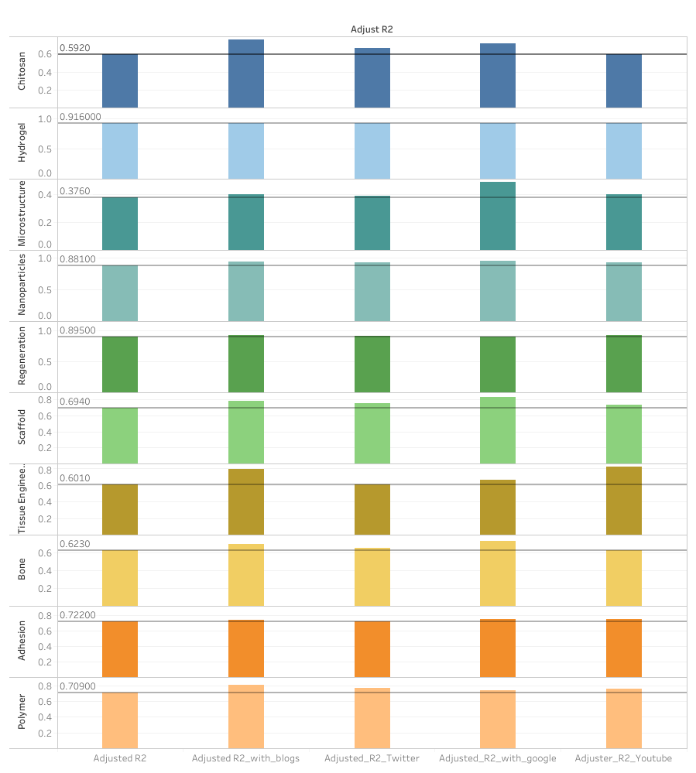
Adjusted
R2 calculation

Slide 26
Conclusion

Slide 27
Time Series
Time series analysis comprises methods for analyzing time series data in order to extract meaningful statistics and other characteristics of the data. Time series forecasting is the use of a model to predict future values based on previously observed values.

Slide 28
Process of Model
Check the Stationarity of a time series
2. Eliminate the trend and seasonality
3. Apply ARIMA model on stationary time series
4. Validate the model
5. Prediction by model

Slide 29
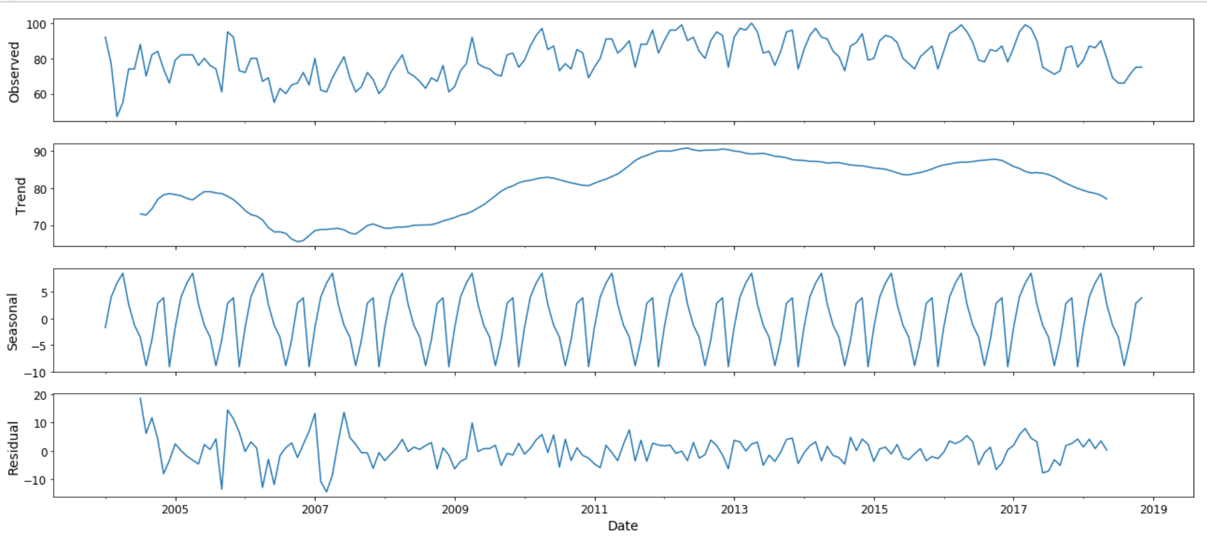
Example | Nanoparticle in Google Search

Slide 30
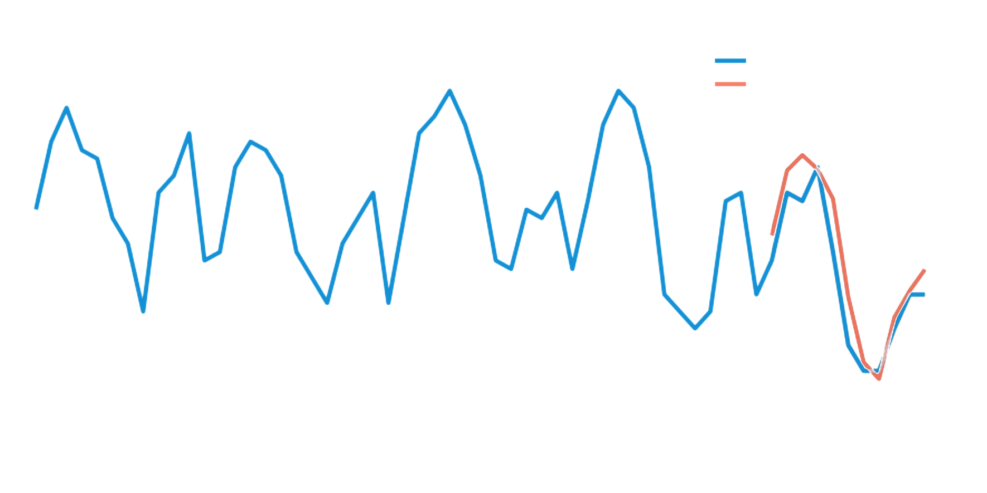
Trends
of
Nanoparticles from 2004 to 2018 in Google Search
100
90
80
70
60
2014 2015 2016 2017 2018 2019

Slide 31
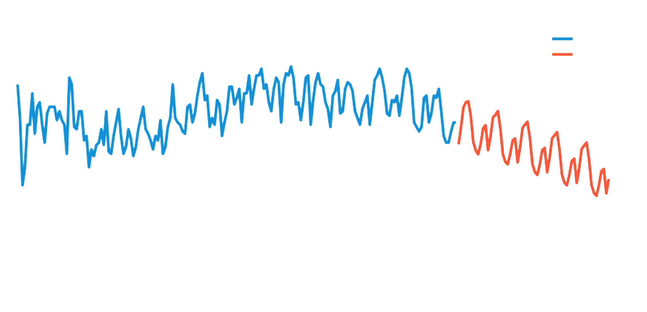
Forecasting
of
Nanoparticles from 2004 to 2018 in Google Search
100
80
60
40
20
0
2004 2009 2014 2019 2024

Slide 32
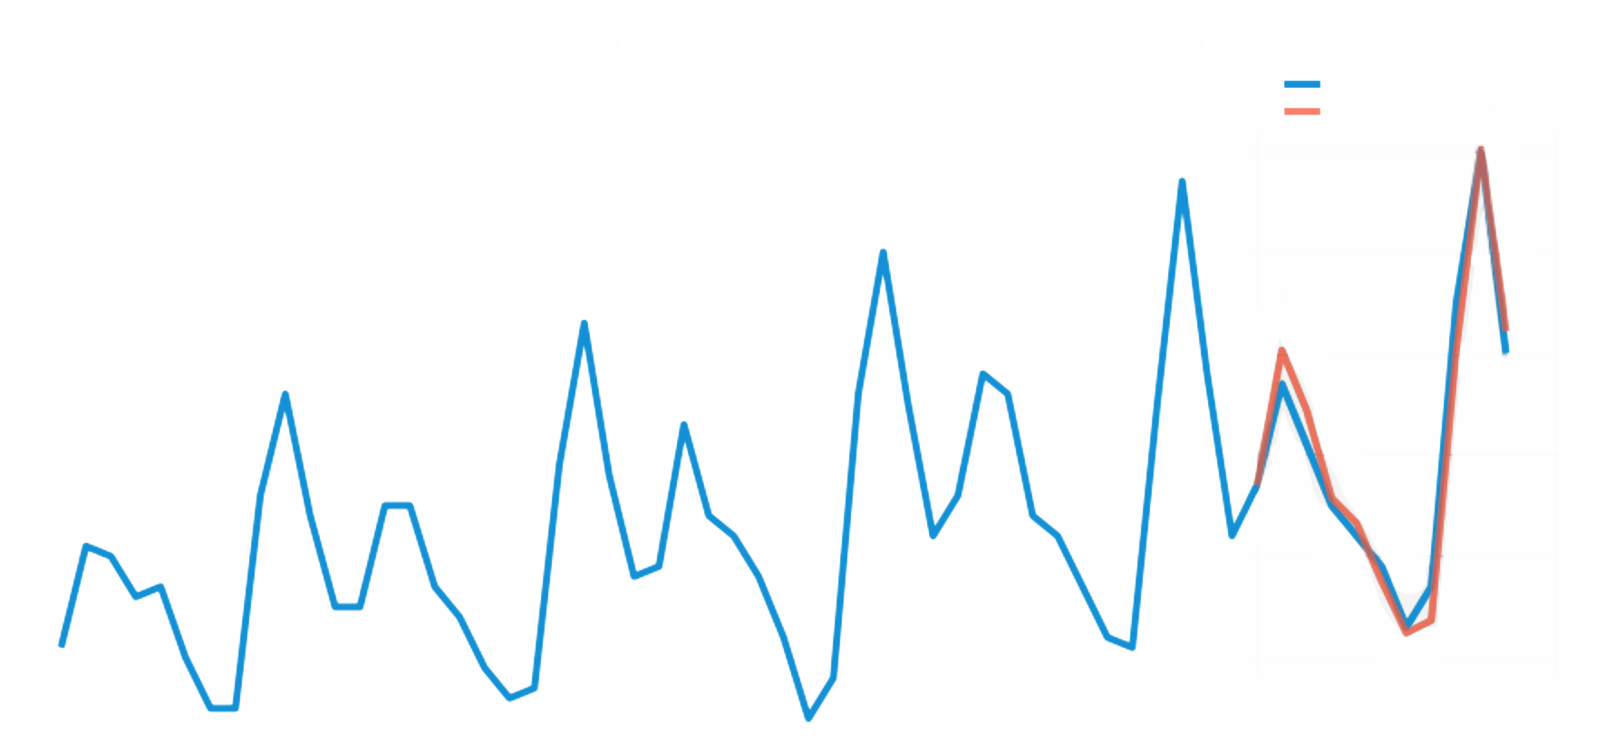
Trends
of
Bone from 2004 to 2018 in Google Search
100
90
80
70
60
50
2014 2015 2016 2017 2018 2019

Slide 33
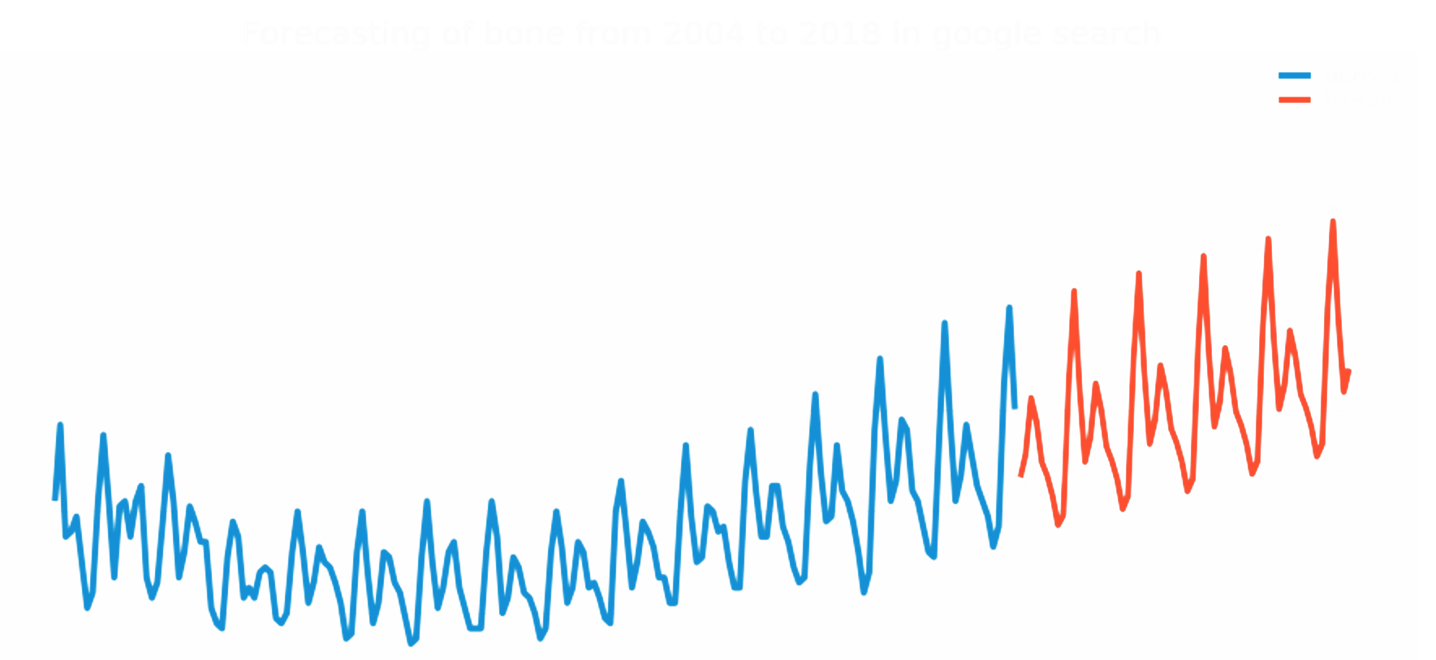
Forecasting
of
Bone from 2004 to 2018 in Google Search
100
90
80
70
60
50
2015 2016 2017 2018 2019

Slide 34
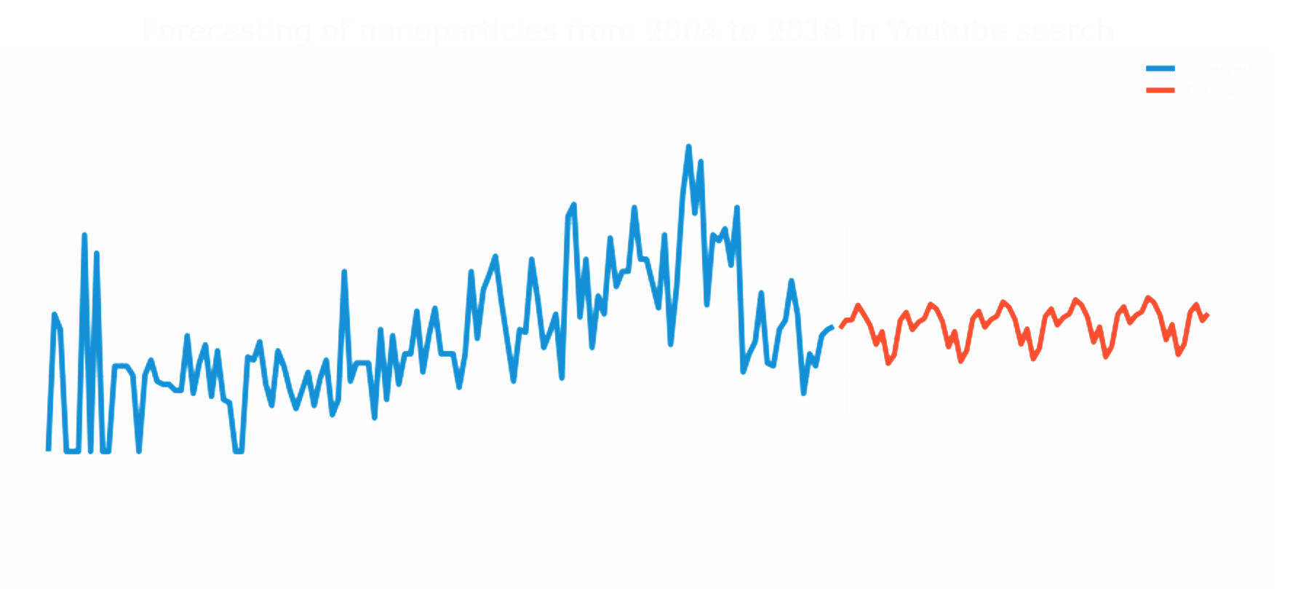
Forecasting
of
Nanoparticle from 2004 to 2018 in YouTube Search
125
100
75
50
25
0
-25
2009 2011 2013 2015 2017 2019 2021 2023

Slide 35
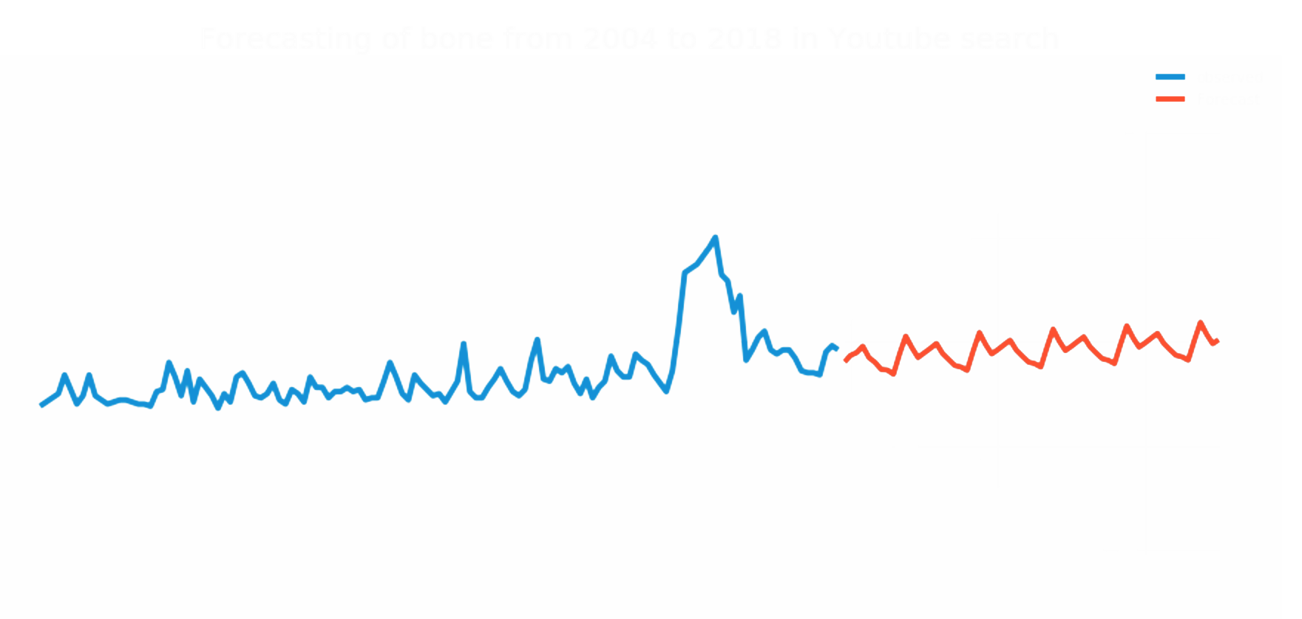
Forecasting
of
Bone from 2004 to 2018 in YouTube Search
150
100
50
0
-50
2009 2011 2013 2015 2017 2019 2021 2023

Slide 36
Conclusion of Time Series Model | Google
1 Years Forecasting
5 Years Forecasting
Stable | Emerging | Shrinking
Scaffold Tissue Engineering | Adhesion Polymer Bone | Microstructure Regeneration Nanoparticles Hydrogel Chitosan
Stable | Emerging | Shrinking
Polymer Regeneration Hydrogel Chitosan Adhesion | Bone | Microstructure Nanoparticles Tissue engineering Scaffold

Slide 37
Conclusion of Time Series Model | YouTube
1 Years Forecasting
5 Years Forecasting
Stable | Emerging | Shrinking
Scaffold Chitosan | Bone | Microstructure Adhesion Polymer Tissue Engineering Regeneration Nanoparticles Hydrogel
Stable | Emerging | Shrinking
Microstructure Scaffold Polymer Tissue engineering Nanoparticles Hydrogel Chitosan Bone | Regeneration | Adhesion

Slide 38

Conclusion

Slide 39
Conclusion
Successfully validated the pervious team’s Research
Proved the effective impact of social media in topic trends
Predicted the future topic trend based on social media

Slide 40
Appendices

Slide 41
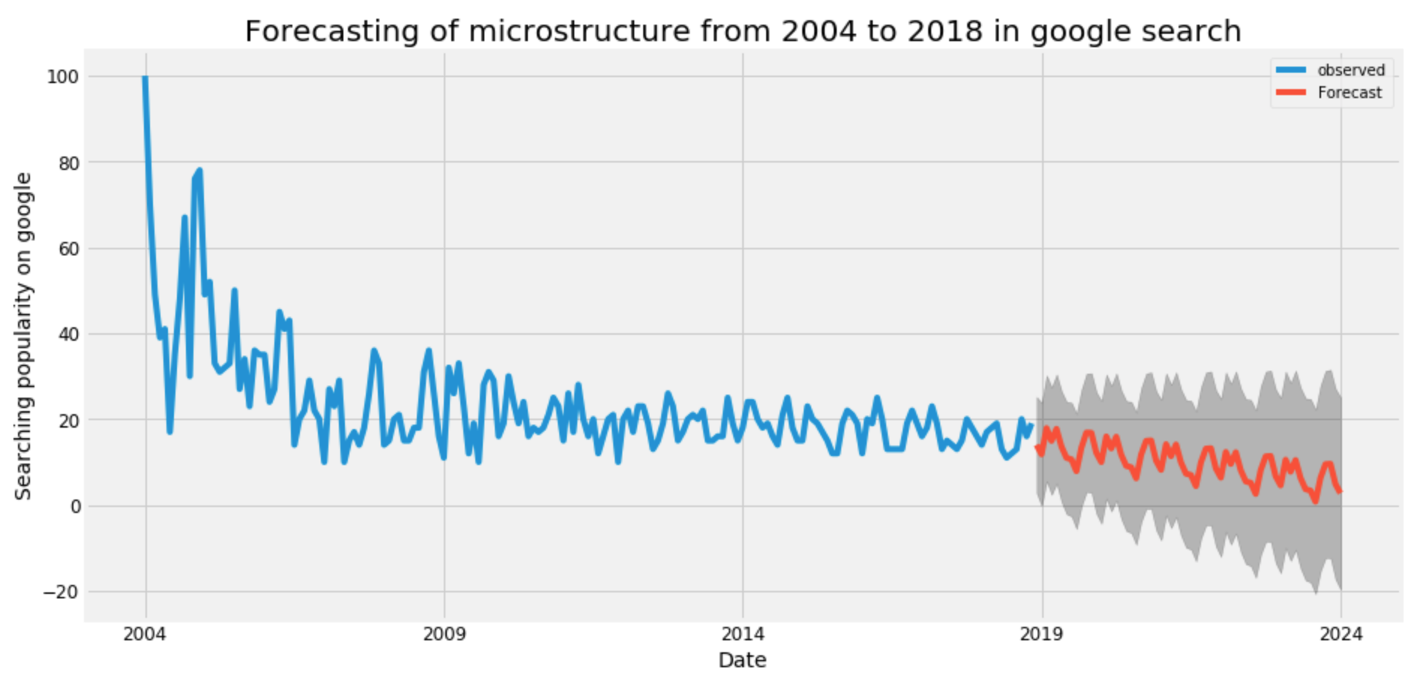
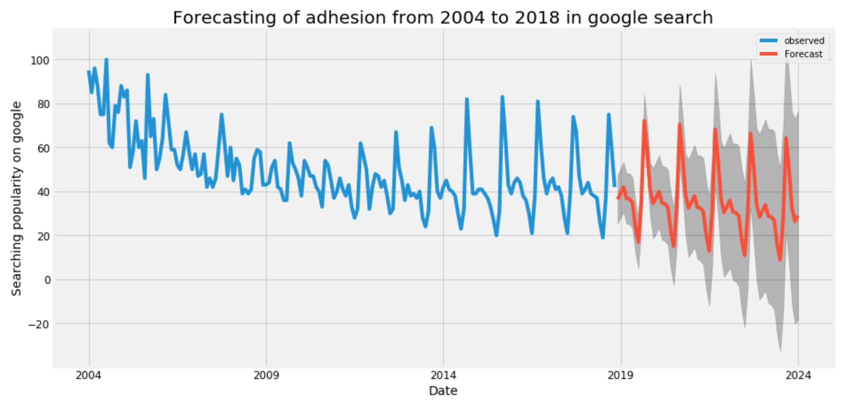
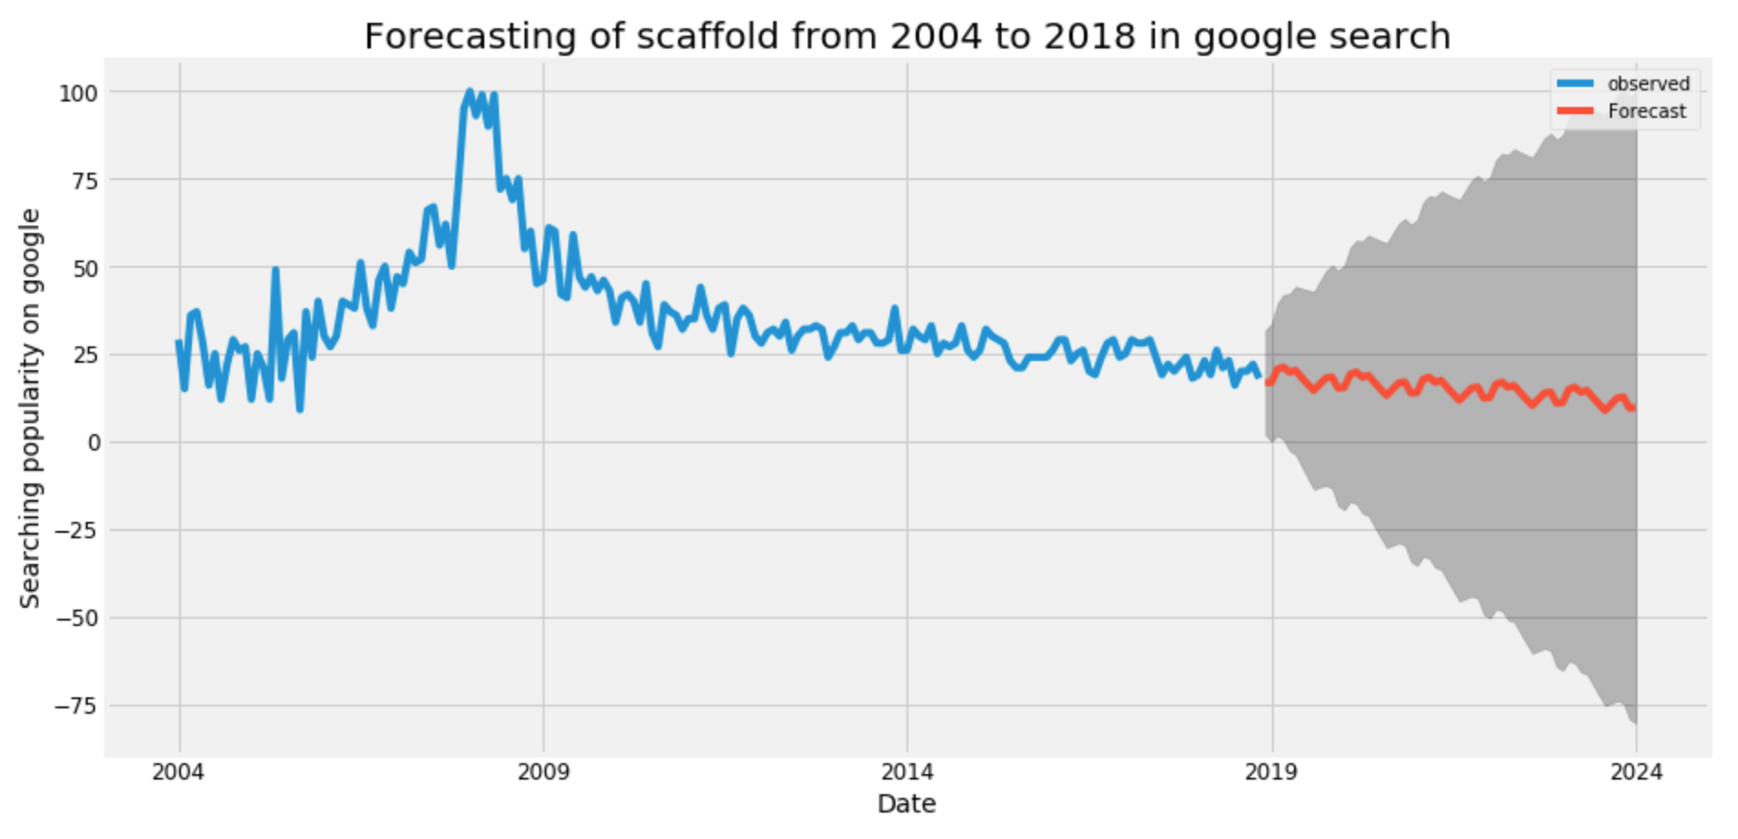

Slide 42
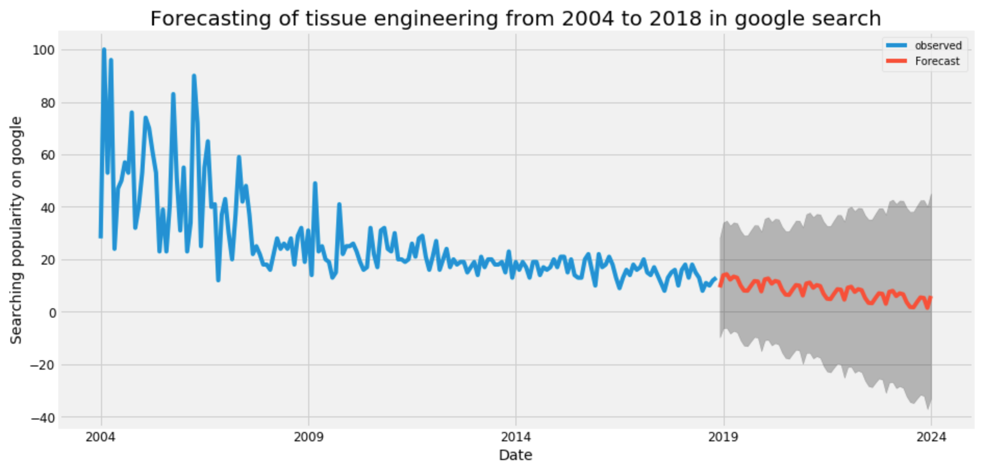
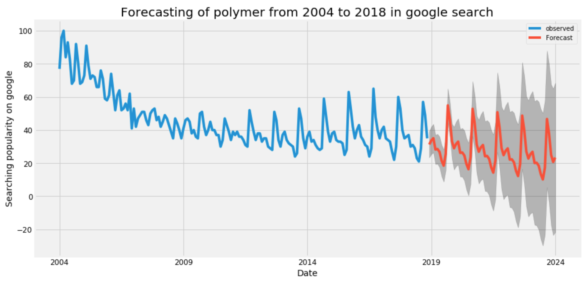
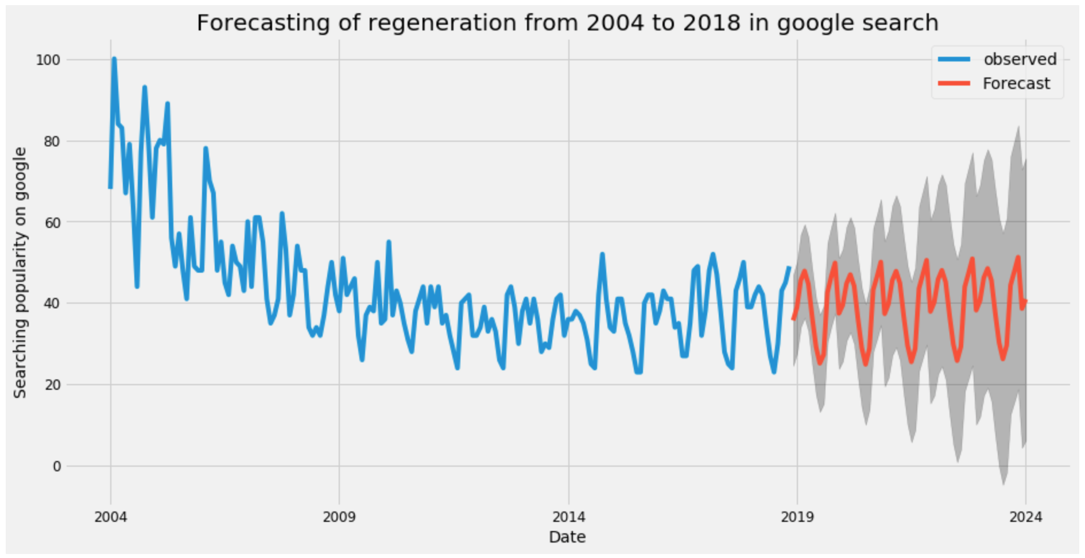

Slide 43
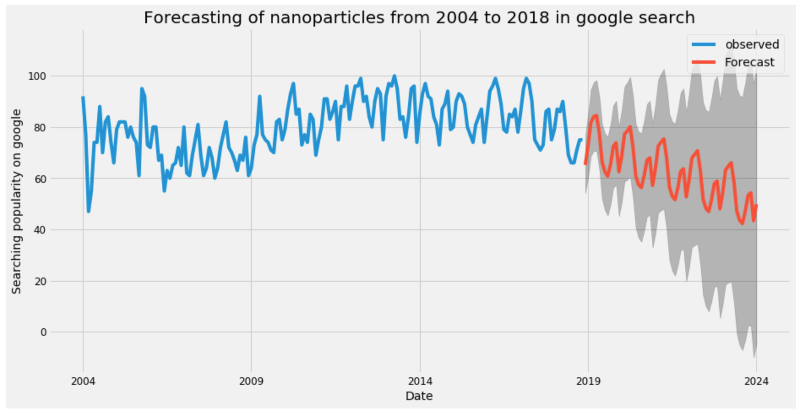
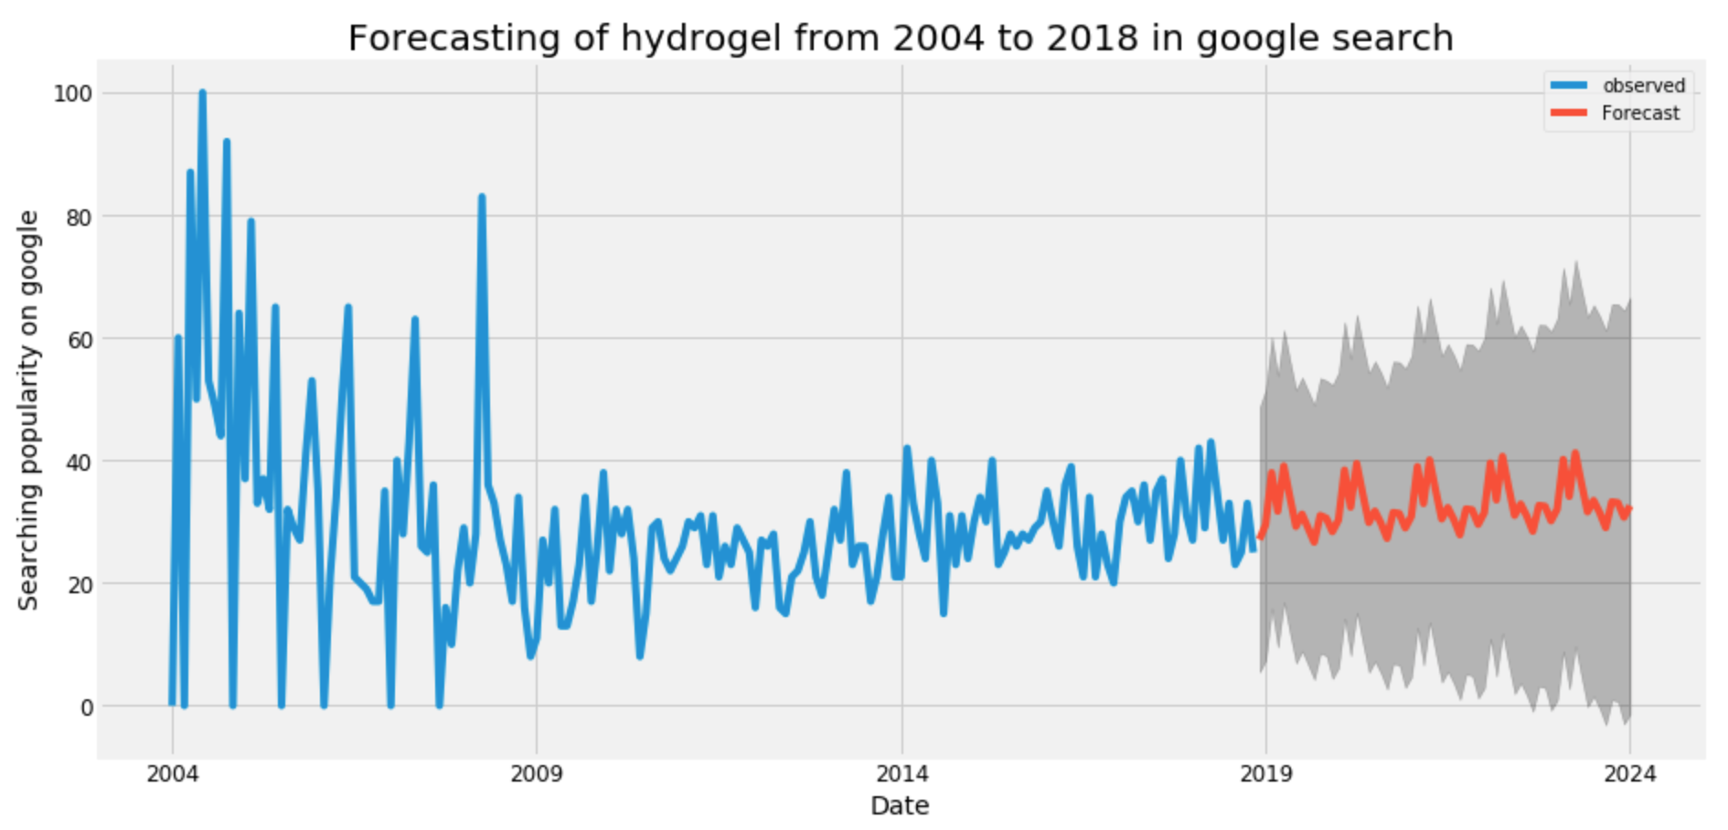
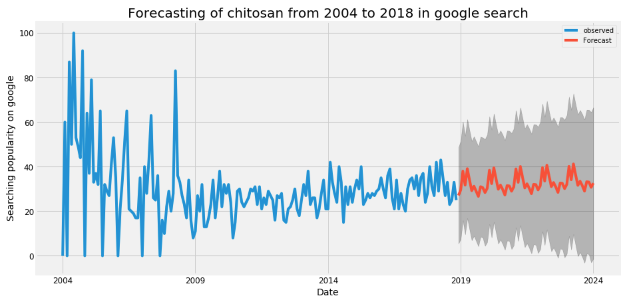

Slide 44
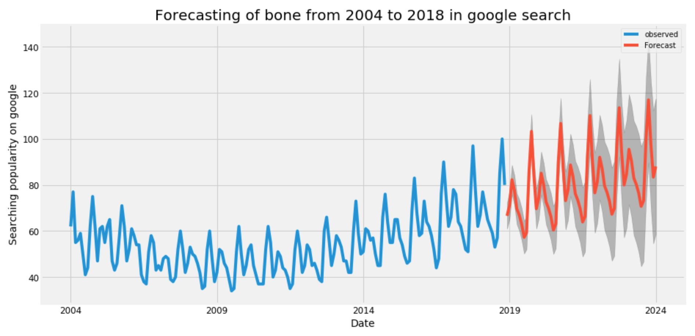

Slide 45
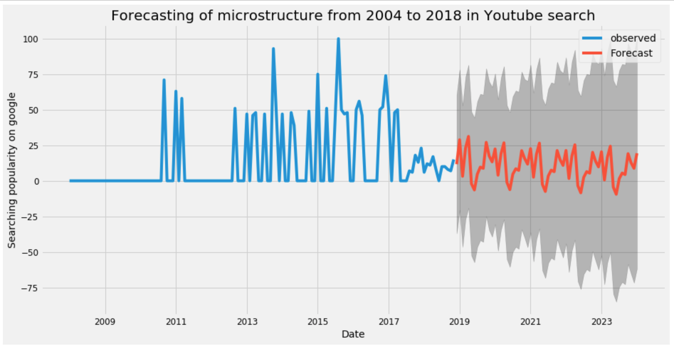
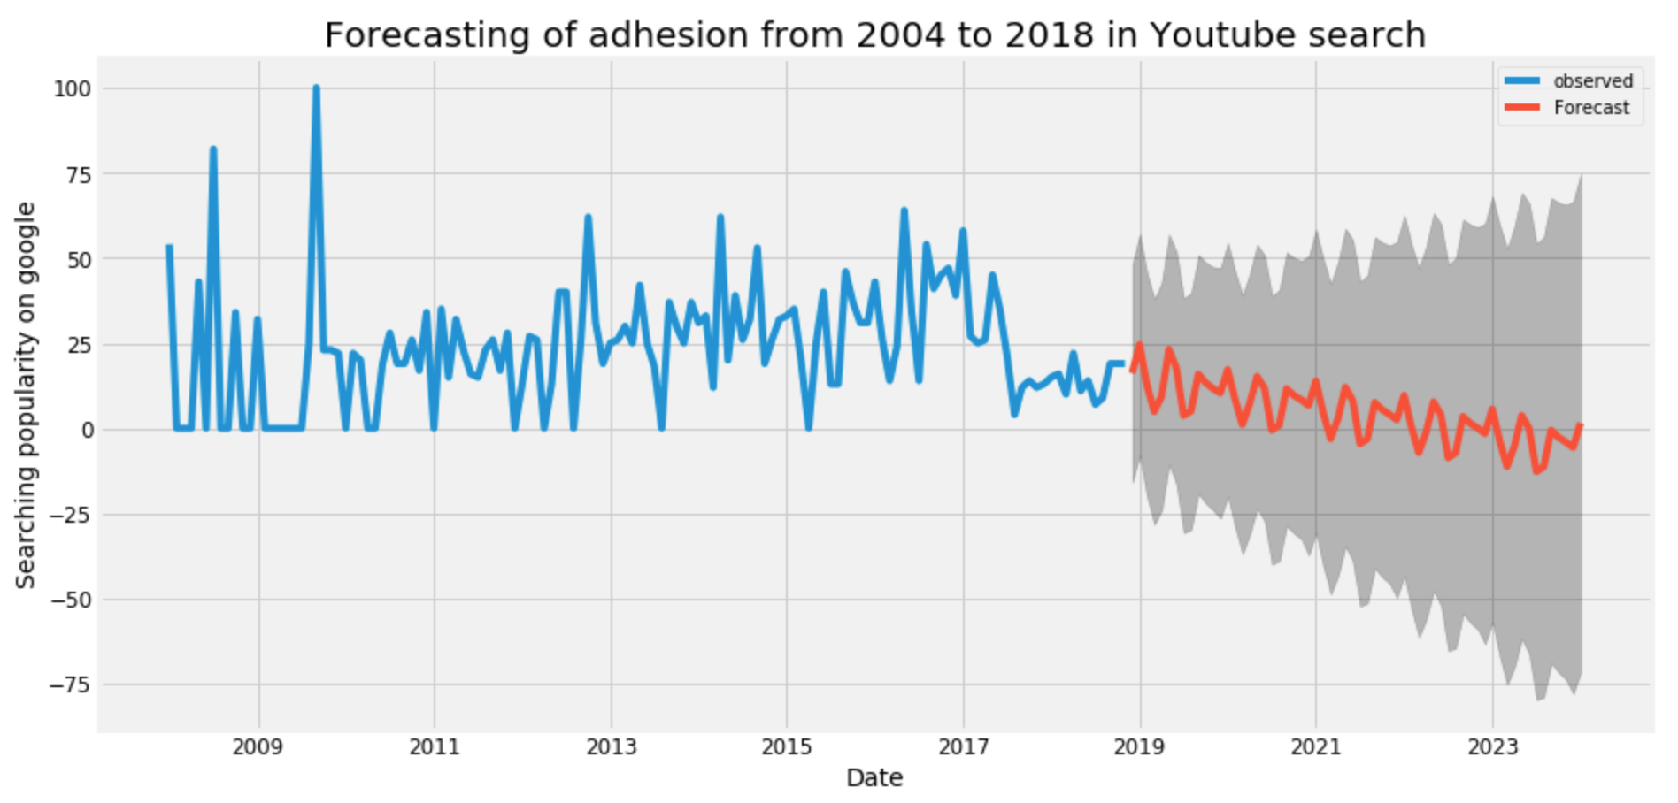
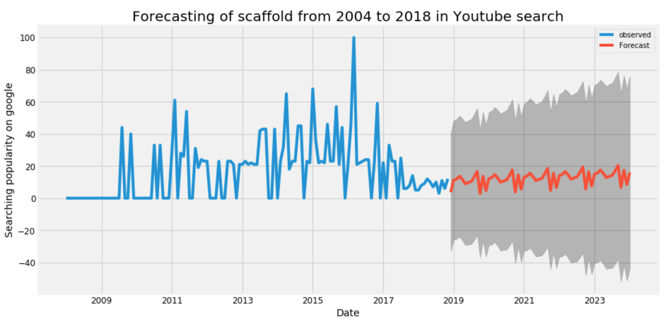

Slide 46
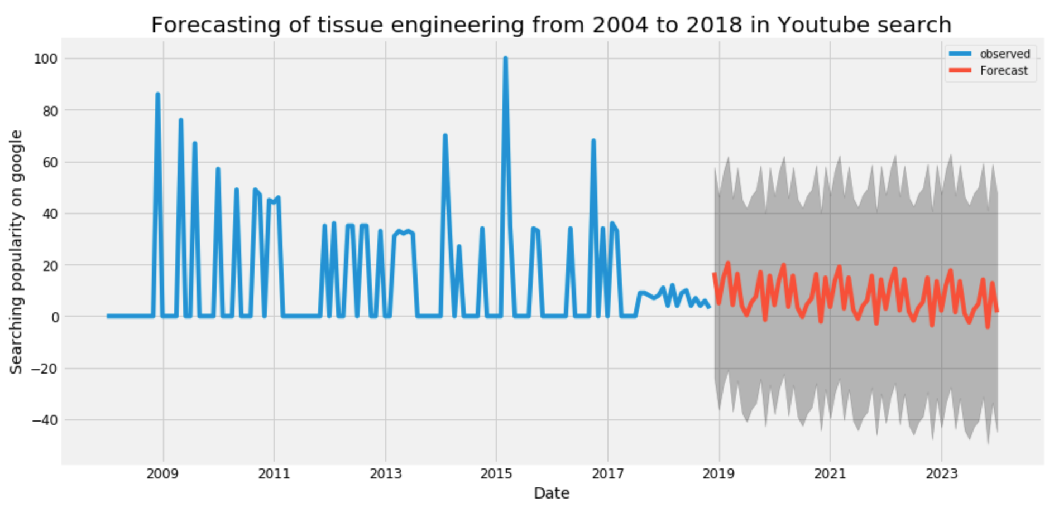
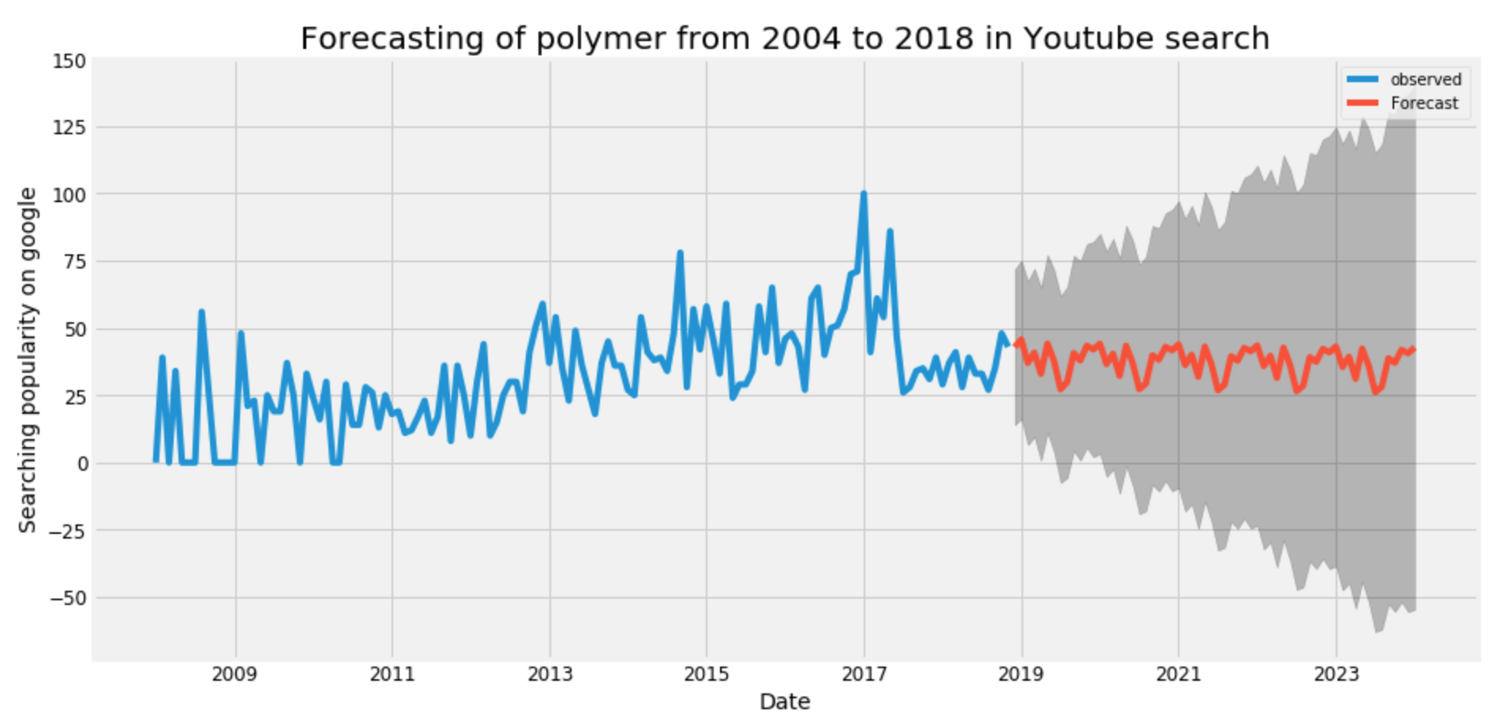
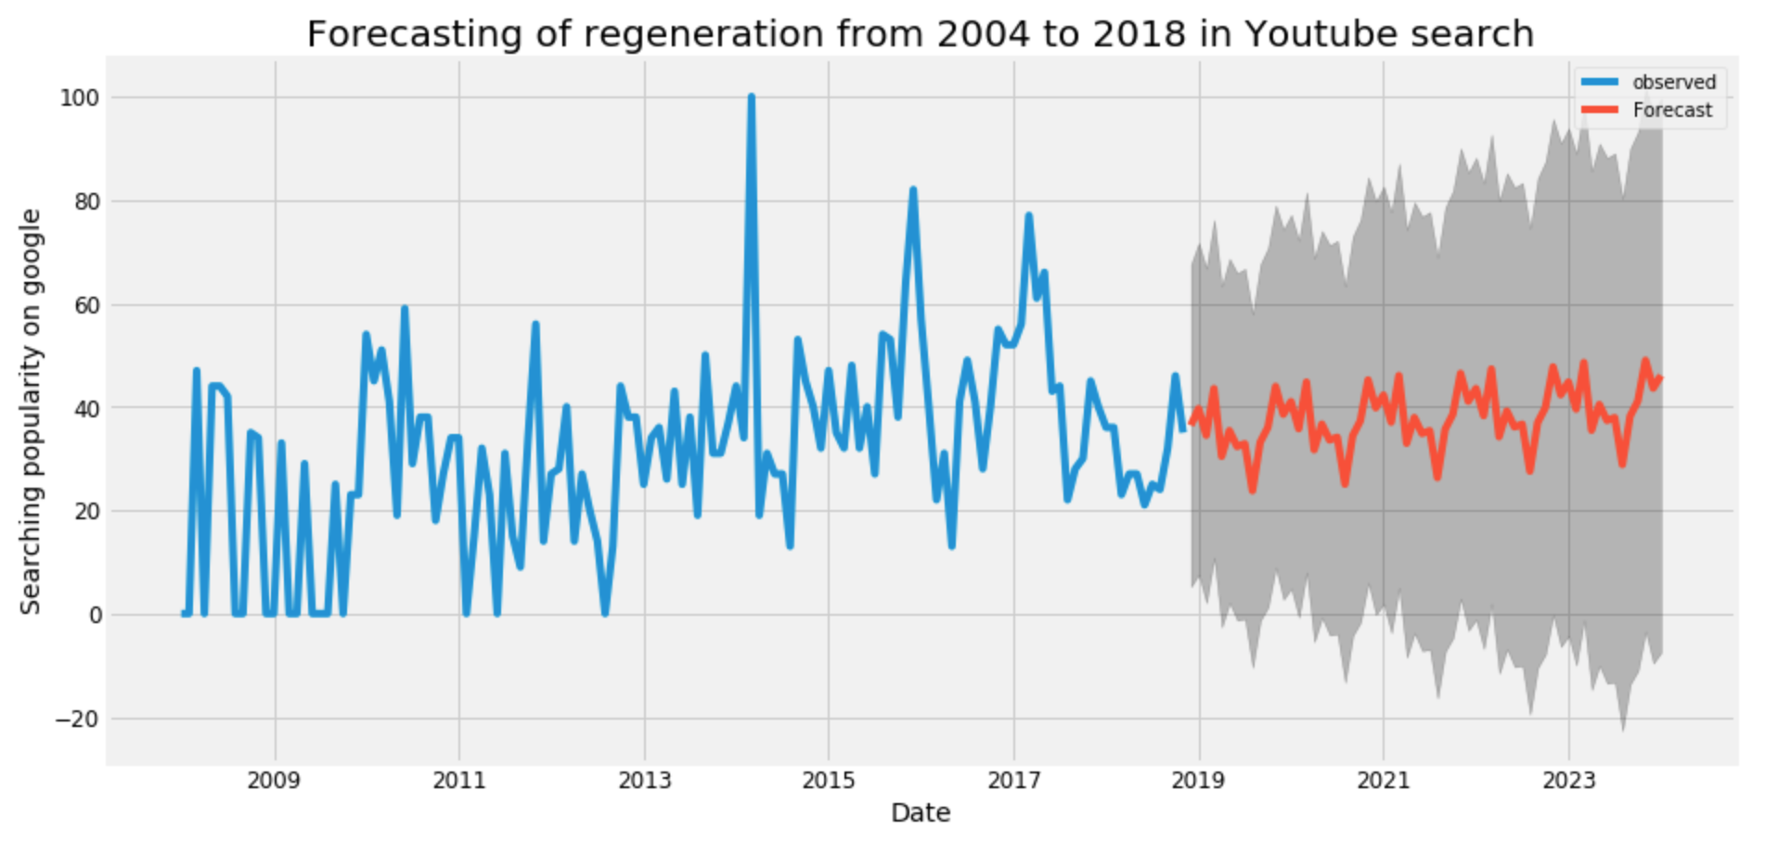

Slide 47
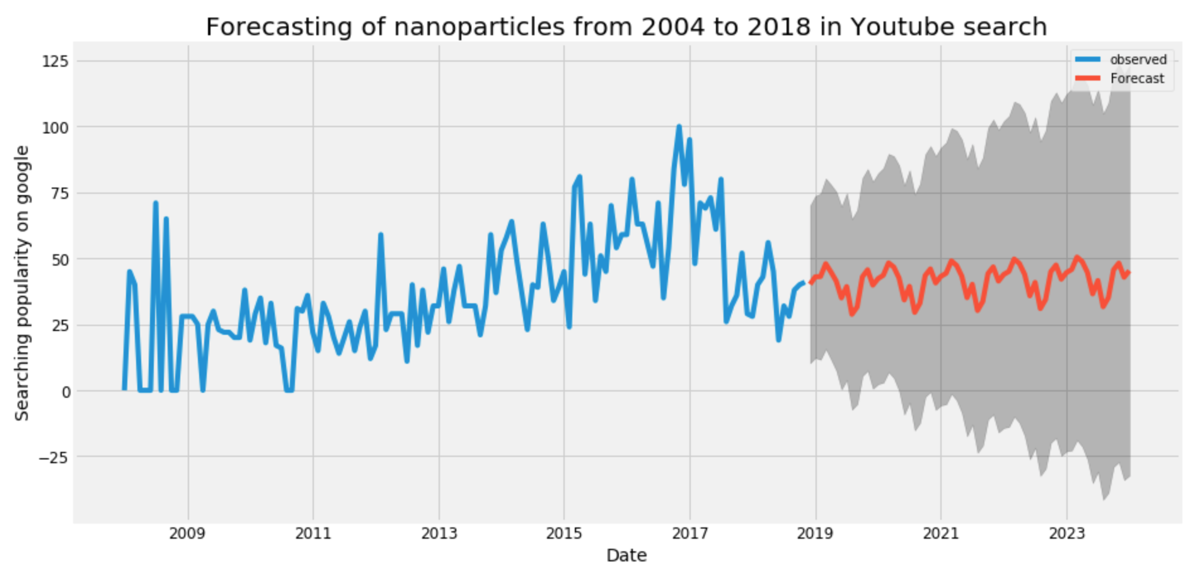
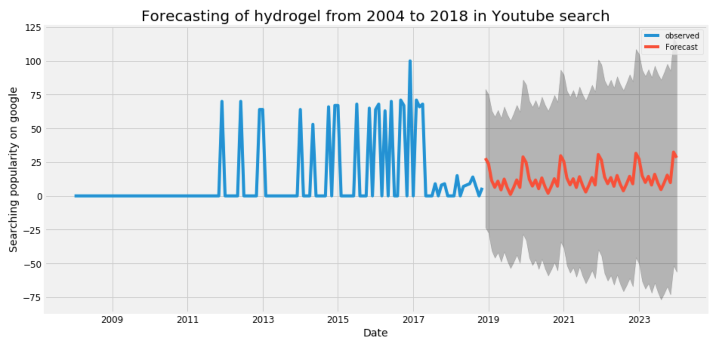
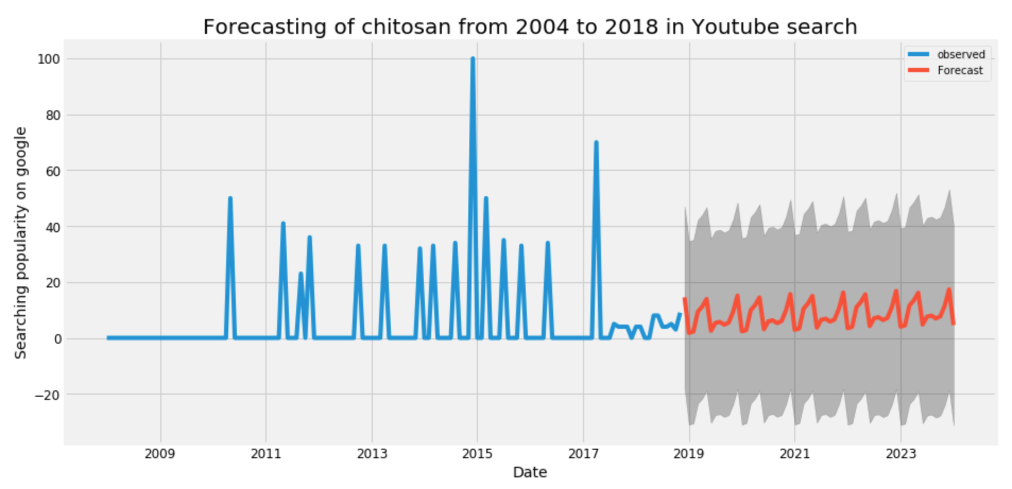

Slide 48
